Slide 1
SKINCARE MANAGEMENT SYSTEM
NAME: DIANA NDINDA NYAMAI
REGNO: 1033977
SUPERVISOR’S NAME: MR. FRANCIS THUO KAMAU

Slide 2
BACKGROUND OF RESEARCH
Usage of skincare products for example body moisturizer, facial cream and hand cream is common among women. The aim of the system will be to guarantee that the clients are able to identify their skin types by taking a skin type test quiz where they will respond to questions involving how they feel the texture of their skin when touched, whether it seems oily or dry, whether when exposed in the sun they get a consuming inclination or not.
The front-end will be implemented using the following technologies: HTML (hypertext markup language), CSS (cascading style sheets) and JAVASCRIPT.
In the backend I will implement using PHP and mysql for database.

Slide 3
PROBLEM STATEMENT
These problems were seen when the system was manual. The records of the data of the customer are manual and incase the documents are lost there’s a risk that the management will not be able to trace the data. Although there are all sorts of products of skincare the challenge comes when the products don’t work on your skin and ends up making it worse or causing skin problems that were initially not there. Statistics shows that only 37% of consumers claim they will only purchase products from brands they can trust and this shows that not all products offered by different companies are safe for your skin and the question arises, how do you know which product to purchase? And how will your skin react to it? Is it safe for your skin? The customers need to visit the store or a dermatologist directly and the appointments or reservations have to be carried out physically. The customers don’t understand or know their skin types hence ends up using products that are not friendly to their skin, or not knowing which products to get. There is no progress of the customer skin improvements being recorded. The store a customer visits may overprice them on the product. The store that the customer visits may have products that aren’t authentic and end up using products that can affect them.

Slide 4
AIM OF RESEARCH
ensure the customers/users get the best organic products that are safe and friendly to their skin.
enable the customers to get a professional advice from a dermatologist if the condition doesn’t improve or if the user has a sensitive skin.
allow the customers to book an appointment with a dermatologist without having to be there physically and get professional advice and treatment.
educate the user about their skin type after the results of the skin test.
enable the customer to get to use products that are authentic and are recommended by dermatologist.
record the number of new customers to visit the system and generate reports based on that.
record the number of appointments made daily, weekly and monthly.
generate system logs of deletion of availability by the dermatologist.
record the products that are mostly being purchased and generate reports on the products preferred according to the trends.

Slide 5
OBJECTIVE OF RESEARCH
ensure the customers/users get the best organic products that are safe and friendly to their skin.
enable the customers to get a professional advice from a dermatologist if the condition doesn’t improve or if the user has a sensitive skin.
allow the customers to book an appointment with a dermatologist without having to be there physically and get professional advice and treatment.
educate the user about their skin type after the results of the skin test.
enable the customer to get to use products that are authentic and are recommended by dermatologist.
record the number of new customers to visit the system and generate reports based on that.
record the number of appointments made daily, weekly and monthly.
generate system logs of deletion of availability by the dermatologist.
record the products that are mostly being purchased and generate reports on the products preferred according to the trends.

Slide 6
SCOPE OF RESEARCH
To ensure the customers/users get the best organic products that are safe and friendly to their skin and provide a skincare routine to follow daily or weekly at the comfort of their home
To enable the customers to get a professional advice from a dermatologist if the condition doesn’t improve.
To allow the customers to book an appointment with a dermatologist without having to be there physically and get professional advice and treatment.
To educate the user about their skin type through taking a skin type test quiz.
To enable the customer to get to use products that are authentic.
To record the number of new customers to sign up in the system and generate reports.
To record the number of appointments made daily, weekly and monthly.
generate system logs of deletion of availability by the dermatologist
To record the products that are mostly being purchased and generate reports on the products preferred.

Slide 7
RESEARCH METHODOLOGY
The project will cover the following:
Describe how the literature review will be conducted
Describe methods of data collected
How the system analysis will be conducted use of use-cases etc
Describe how the system design will be done
Describe how the implemented will be conducted
How the system will be tested
How the system will be deployed

Slide 8
REVIEW OF RELATED WORK
The chapter will describe the other examples of the similar system that exist in the real word.
For example: sokoglam, sunzapp, Skincarebyalana
The chapter will also cover the emerging trends, and research gap

Slide 9
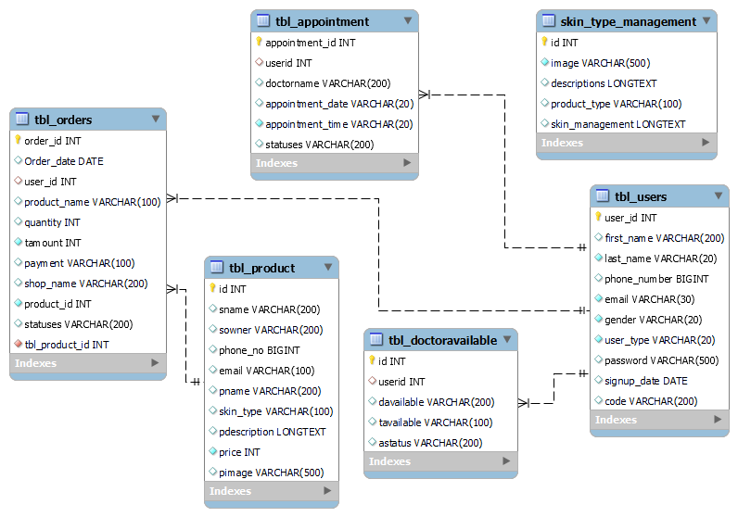
DATABASE DESIGN

Slide 10
CONCLUSION, CHALLENGES & FUTER RECOMMENDATIONS
In conclusion, skincare management system is a good solution for the users trying to find the products that will be safe for their skin. The system provides a way to not only recommend the best products but to also help them understand the type of skin they have and the products that will be safe for their skin.
The challenges encountered during this project period include:
Inability to do interviews due to the Covid-19 pandemic
Debugging errors involved with the system
Using programming languages that had neglected and re-learning them
For the future, I would recommend a system that tracks the users progress on their skin from using the products recommended in the system.

